Slide 1
blogabc Technology Document
Lu Han
2009-7-17

Slide 2
overview
Tech | Project
MVC framework | spring2.5.6
O/R mapping | hibernate3.3.1
Ajax | Buffalo
Rich Text Editor | FCKEditor

Slide 3
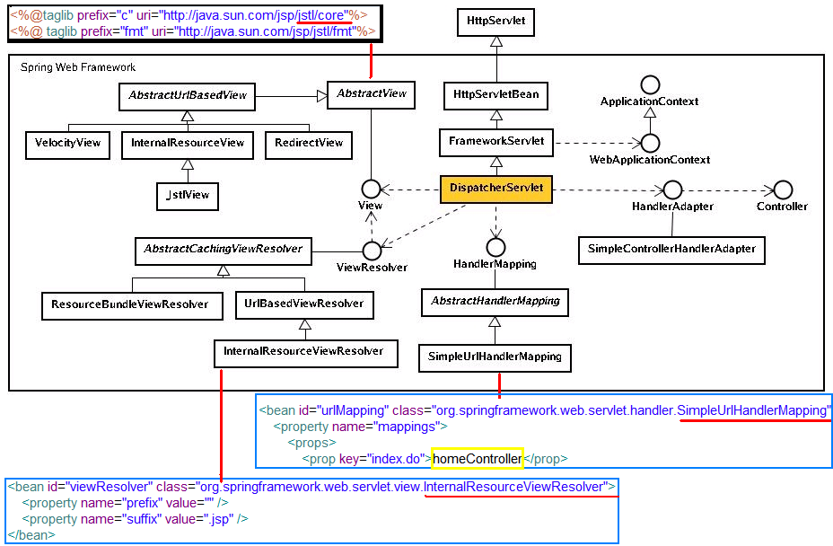
spring2.5.6

Slide 4
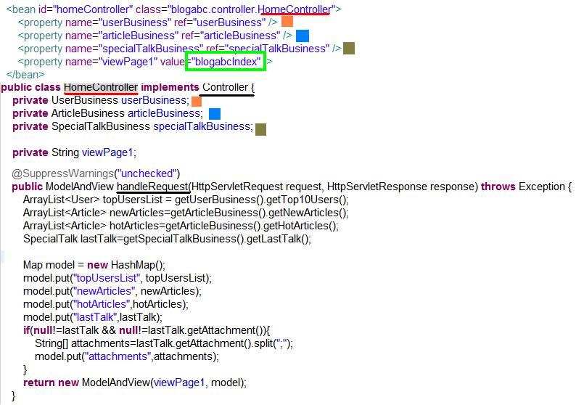
spring2.5.6

Slide 5
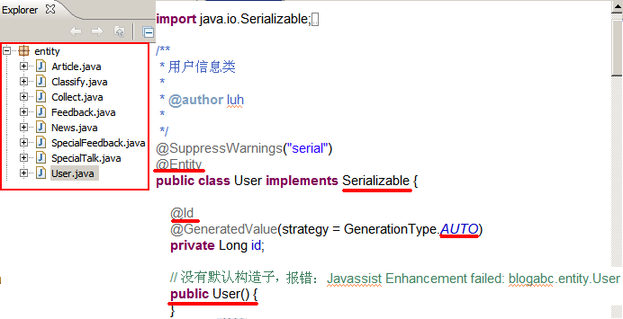
hibernate3.3.1
Ivp-Java – jibx – xml-device
App-Java - xdoclet - hbm.xml- hibernate core-db

Slide 6
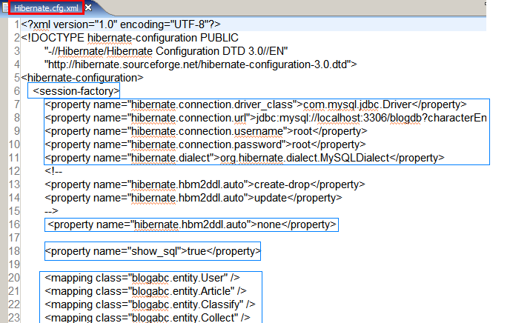
hibernate3.3.1

Slide 7
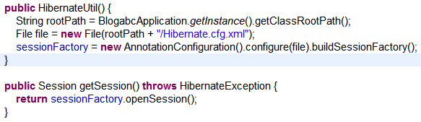
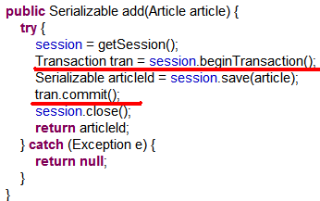
Spring-hibernate

Slide 8
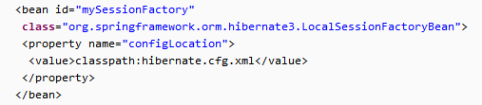
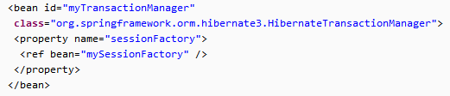
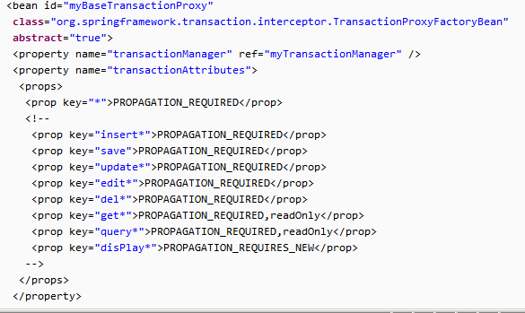
Spring-hibernate

Slide 9
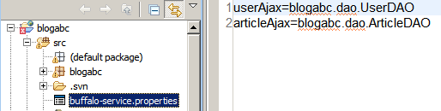
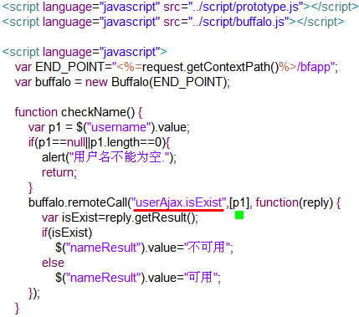

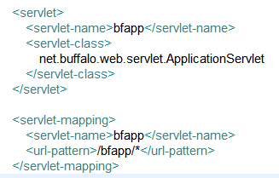
Buffalo

Slide 10
overview
FCKEditor

Slide 11
Buffalo

Slide 12
FCKEditor

